Slide 1





Empowering Youth For Civic And Environmental Engagement though Problem-Based Learning and Tools for Collaborative Mapping
Presenter: Irene Liang
Space Grant Mentor: Barron J. Orr, PhD
Space Grant Symposium, University of Arizona
21 April 2012
Special Acknowledgements: Kristin D. Wisneski, Nicholas B. Knutson, James H. Vancel
Funding for this work was provided in part by NASA Space Grant and in part by USDA. The research and the development of the Akshen.org application suite are being supported by the U.S. Department of Agriculture (USDA) National Institute of Food and Agriculture (NIFA) National Research Initiative grant #2009-55215-05187.

Slide 2
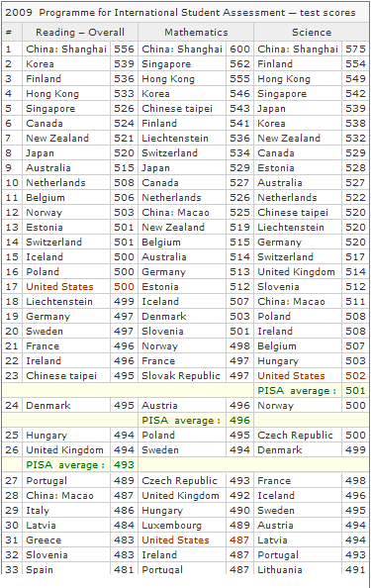
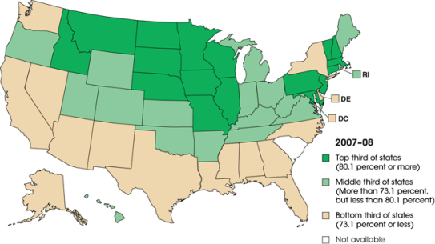
Education in the United States
High school graduation rate: 74.9%, this is lower than for most developed countries
Rank in Math: #31
Rank in Science: #23
Source: http://dashboard.ed.gov/statecomparison
Source: OCED 2009 Program for International Student Assessment
Notes:
PISA is an assessment for 15-year olds in 65 principal industrialized countries; US = below average in math, average in science.

Slide 3
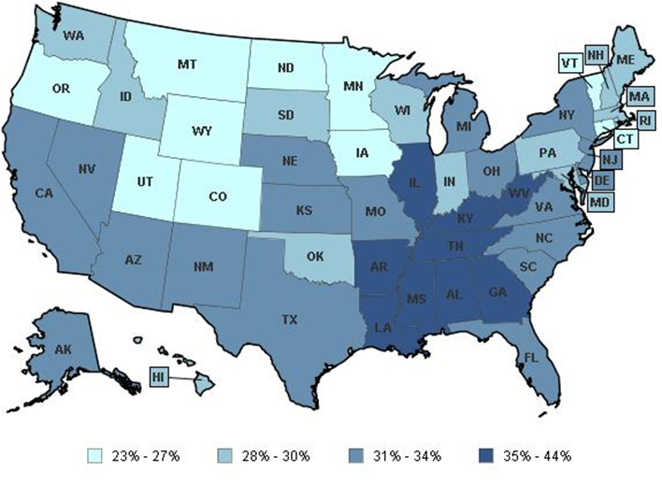

% of Youth Overweight or Obese
http://datacenter.kidscount.org/data/acrossstates/

Slide 4
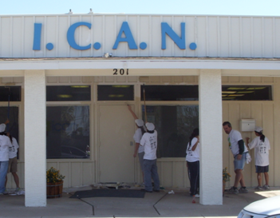
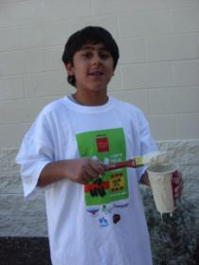
Adolescents are at risk
HIGH
High-school dropout rates
Adolescent obesity rates
LOW
Awareness of community potential/problems
Civic and nature engagement
Formal Education
Passive learning
Standardized tests
Less effective
“Sage on the stage”
Kids re-paint the ICAN Youth Center

Slide 5
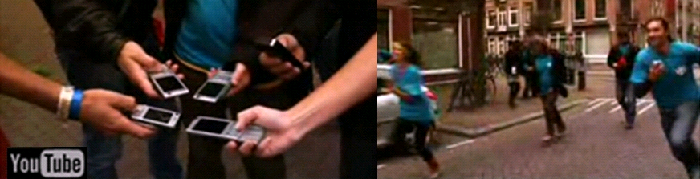
The Solution: PBL through Technology
“Sage on the stage” versus “Guide on the side”
PBL = Problem-Based Learning = Active Learning
Enable a youth-driven approach
Use technology to trigger interest in a problem to be solved
Provide scaffolding that emulates video game concepts
Encourage questioning and reflection
Cultivate critical thinking skills
Raise awareness that reality is dynamic rather than static
Notes:
Kids are interested in technology, games, and social media

Slide 6


.org
Get active… Take action!
Research and Development Goals
youth-driven civic engagement: enable them to identify and solve a community/environmental problem
informal STEM learning
active and healthy lifestyles
L6
L5
L4
L3
L2
L1
Trigger interest– “Trick” adolescents into discovering community problems/potential through photography
Empower – Mastering fun GPS and GIS tools for community asset/problem mapping and basic geospatial analysis
Facilitate – Create a scaffold to guide the PBL process

Slide 7
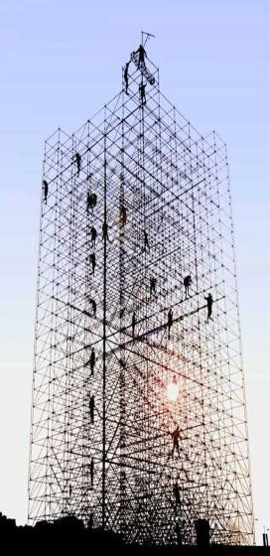
A key PBL concept: Scaffolding
Scaffolding permits guiding without telling…so that adolescents can identify and solve a community or environmental problem with very limited instruction.
Level 8: Take action!
Level 7: Communicate results
Level 6: Analyze/interpret data
Level 5: Collect/Compile data
Level 4: Make a Plan
Level 3: Conduct background research
Level 2: Identify a problem and pose questions
Level 1: Gain awareness

Slide 8
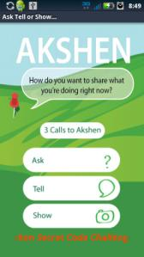
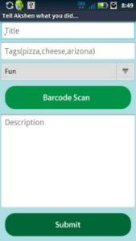

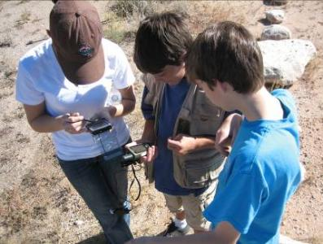

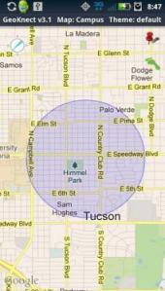
“What’s your Problem?”
Application Suite
Akshen.org
GeoSnap
GeoKnect
“What’s your Problem?”

Slide 9
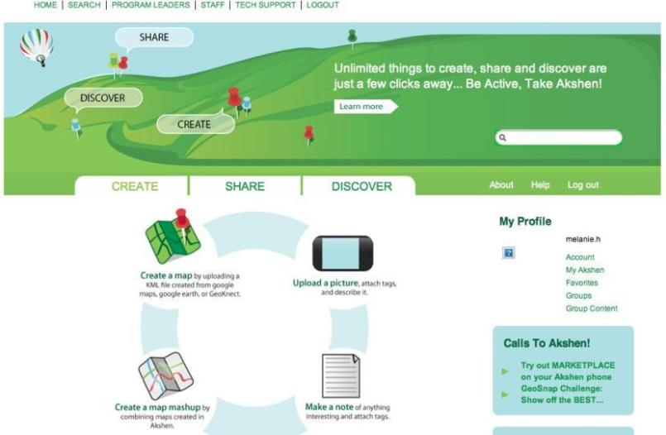
Akshen.org Website

Slide 10
The Approach
Facilitators/ Creative Team
Software developers
Researchers
13 youth interns (aged 12-19)
technological “super users”
Formative process
Participatory research & development
Highly interdisciplinary:
-Earth scientists
-Computer scientists
-Nutritional scientists
-Youth development specialists
-Anthropologists
-Biostatisticians

Slide 11
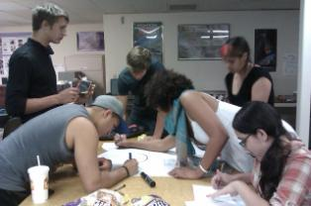
Results
Top Community Issues Identified by Youth
Safe/Dangerous places
Food access
Natural Spaces
Transportation
Vandalism
Environmental quality
Content, language, and design
Scaffolding and website
Documentation of specifications
Demonstration Projects
EcoConnections
Food Deserts
Concepts and learnings from the youth
Common youth and community Issues
Ideal incentives for participation (economy)
Popular technologies among adolescents

Slide 12
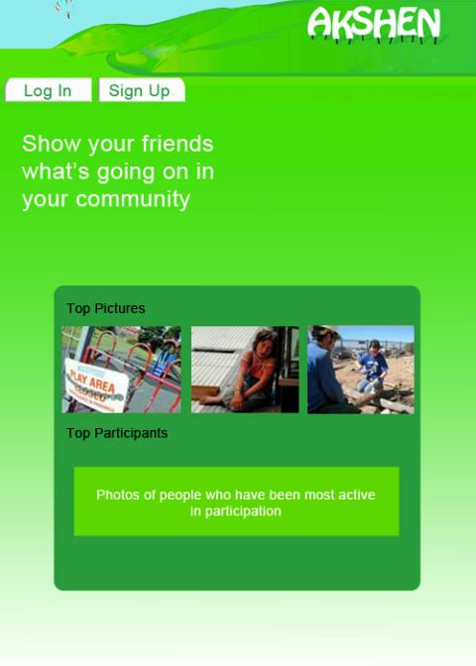
goes to screen 3
goes to screen 3
Introduction of what will happen in this level (subtle-ish)
Sample Pictures
Photo database: static pictures
E: Selected form Participation Points Database based on total points
User photos of those top participants
Color Green=GeoKnect
Introduction screen lvl 1 screen 2

Slide 13
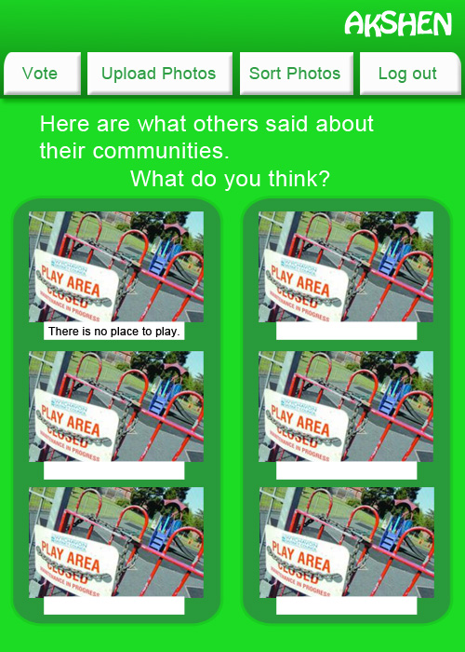
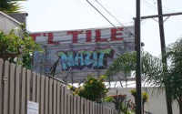
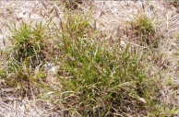
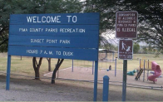
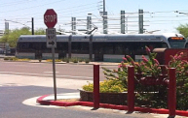
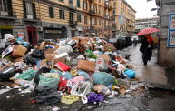
Logs out of username, exits to screen 2
Links to screen 13
Link to screen 12 also to apply the photos onto the page
Goes to photo database
Directions to guide users into deciding the type of pictures to take
Bad tags
Each pic when clicked links to a screen similar to screen 6 mockups
-Will only be 4 Screens in the end
Images chosen by stealth health staff as static images. Along with comments
Invasive - causes fire
We need a park!!
Train would be cool
What a mess!
Getting started page lvl 1 screen 4

Slide 14
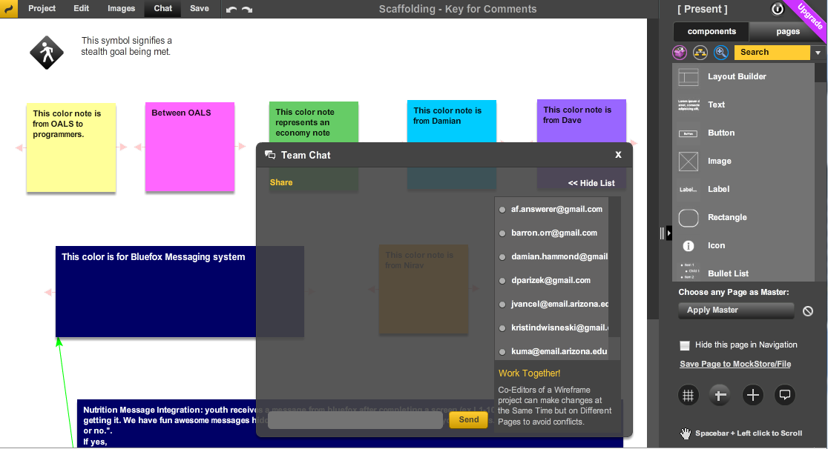
Wire-framing with Mock-flow
“Design, collaborate user interface concepts for your software and websites. “
(http://app.mockflow.com/)

Slide 15
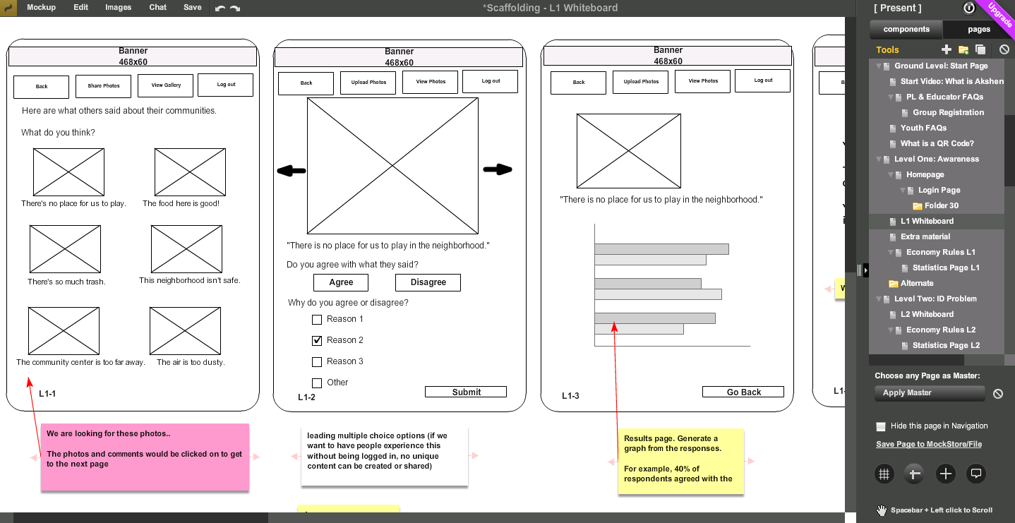
Wiring for L1 Raise Awareness
(http://app.mockflow.com/)

Slide 16
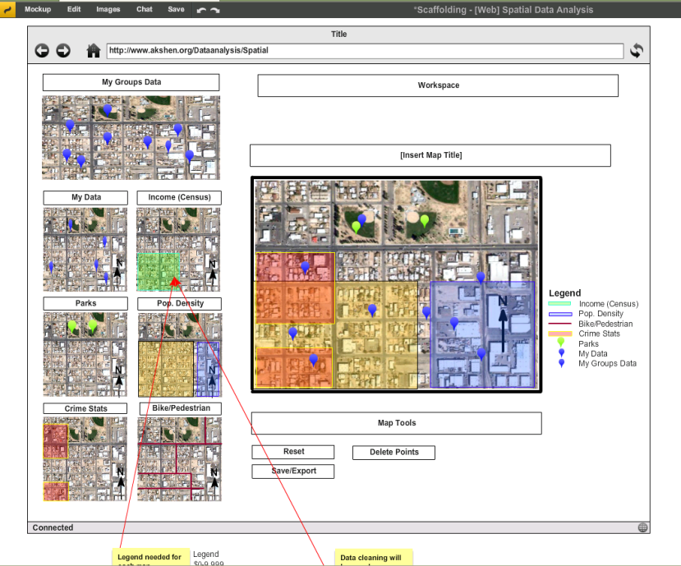
Wiring for L6 Data Analysis

Slide 17
Results: The Journey in Itself
Insight from the process
The interns were engaged in a problem of their own-- to motivate their peers through a PBL process of awareness and community building
Reflections from the Youth Interns
“I got to learn lots of new things such as how it is working in a group, trying to think of new exciting innovated ideas, and how I can improving my work habits in the future.”
“Working as a team was a very unique and helpful experience. Being able to bounce ideas off of other people helped.”
“We had to keep overlooking all the levels to see how we could make it better and what we were missing.”
“It was challenging working in a team who had so many different types of views on things.”

Slide 18
Moving forward..
High confidence in the potential for success based on insight from the development process
Programmers have started developing and new questions are surfacing: databases, algorithms, branching
The potential of PBL theory beneath online and mobile education applications is clear:
Promotes informal STEM learning
Results in use of the scientific methods without teaching the scientific method
Promotes collaborative learning
Builds confidence and promotes leadership skills

Slide 19





Acknowledgements
Barron Orr, PhD
Kristin Wisneski
Nicholas Knutson
James Vancel
Nirav C. Merchant
Damian Hammond
Dave Parizek
Stealth Health Investigators
Ironwood Tree Experience
Poli Joshevama
Alegria Gray
Katie Martinez
Matt Clark
Bernd Steklis
Wulf Steklis
Downtown YMCA
Darius Dumel
Northwestern YMCA
Jordie Farias
Stacie Tomlin-Brown
Chesalon Walton
Skrappy’s Youth Center
Alex Contreras
Alfonzo Contreras
Austin Kerg
Arizona Space Grant Consortium
United States Department of Agriculture (USDA)
Arizona Remote Sensing Center
Office of Arid Land Studies
Arizona Research Laboratories/Bio 5 Institute
USDA-NIFA National Research Initiative grant #2009-55215-05187.

Slide 20
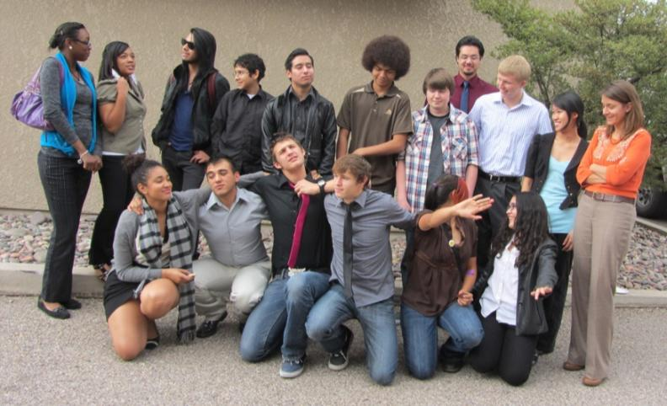
Thank You

